Slide 1
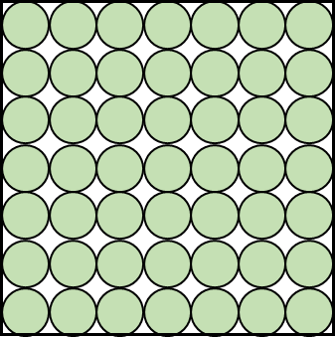
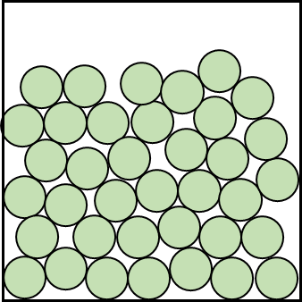
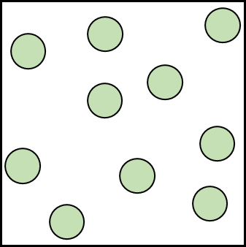
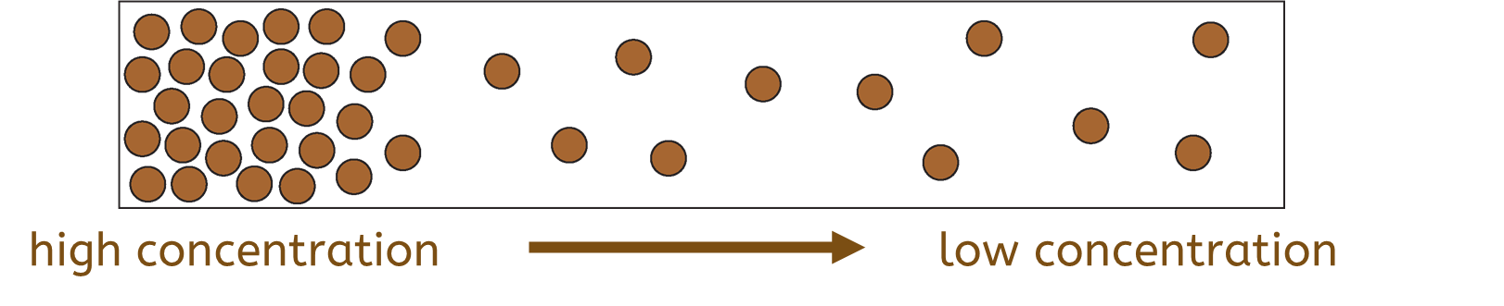
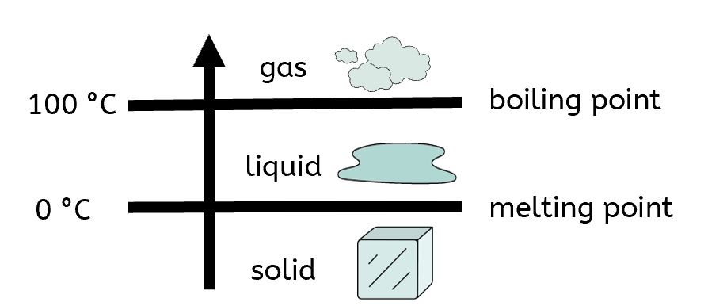
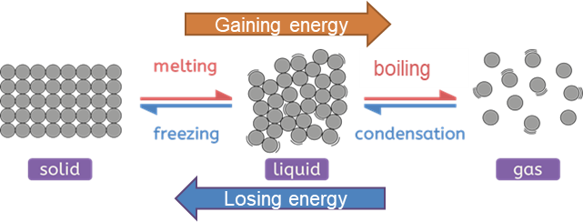
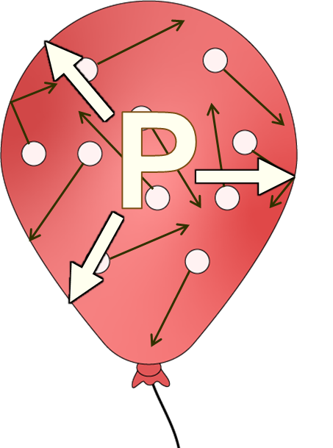
Particles, substances and mixtures
Explaining the properties of solids
Property | Reason
Fixed shape and cannot flow | Strong forces of attraction between the particles keep them in fixed positions.
Cannot be compressed (squashed) | Particles are all touching and have no space to move into.
The particle model of matter
Diffusion
 | Solid | Liquid | Gas
Diagram
Arrangement | ordered and all touching | random and all touching | random and not touching
Movement | vibrate in fixed positions | move and slide over each other | move around quickly in random directions
Attraction between particles | strong | weak | very weak
Diffusion is the random movement of particles from an area of high concentration to an area of low concentration. Particles of substances in the liquid and gas states can diffuse because their particles can move freely.
Explaining the properties of liquids
Property | Reason
Takes shape of container and can flow | Weak forces of attraction between the particles, so they can move around each other.
Cannot be compressed (squashed) | Particles are all touching and have no space to move into.
Melting and boiling points
melting point: the temperature at which a substance changes from a solid to a liquid
boiling point: the temperature at which a substance changes from a liquid to a gas,
e.g. water
Explaining the properties of gases
Property | Reason
Takes shape of container and can flow | Very weak forces of attraction between the particles, allowing them to move and spread out.
Can be compressed (squashed) | Particles are not touching and have space to move into.
Change of state
Gas pressure
A change of state is a physical change because no new substances are made, and the change is reversible. Only the amount of energy the particles have changes, which affects the arrangement and movement of the particles. Temperature stays constant during a change of state.
When gas particles collide with the walls
of their container, this creates a constant
force on the walls of the container.
This causes pressure. The faster the particles
move, the higher the gas pressure. The gas pressure inside containers can be increased by adding more particles or increasing the temperature. The more frequent the collisions, the higher the gas pressure.
Science | 7.01 – Particles, substances and mixtures | Knowledge Organiser
Notes:
Images:
All images – United Learning

Slide 2
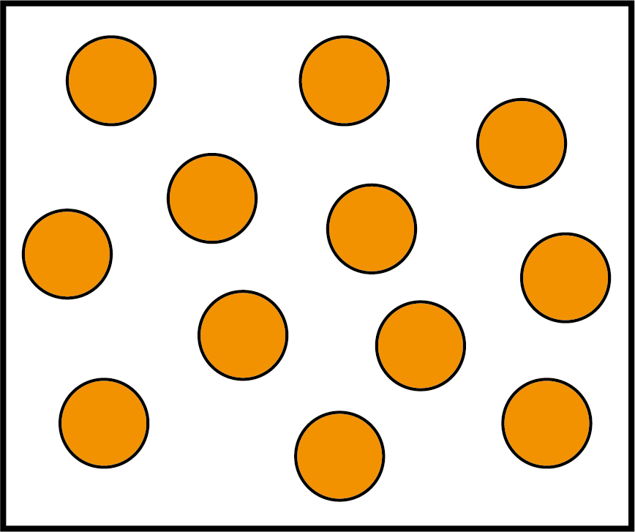
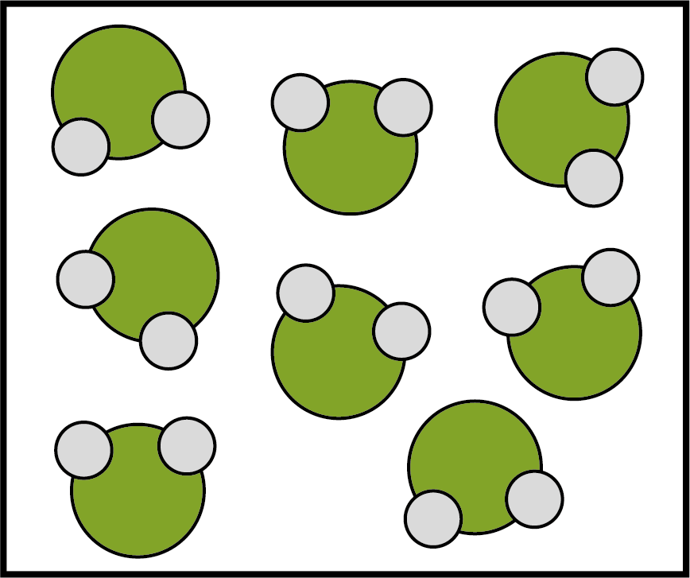
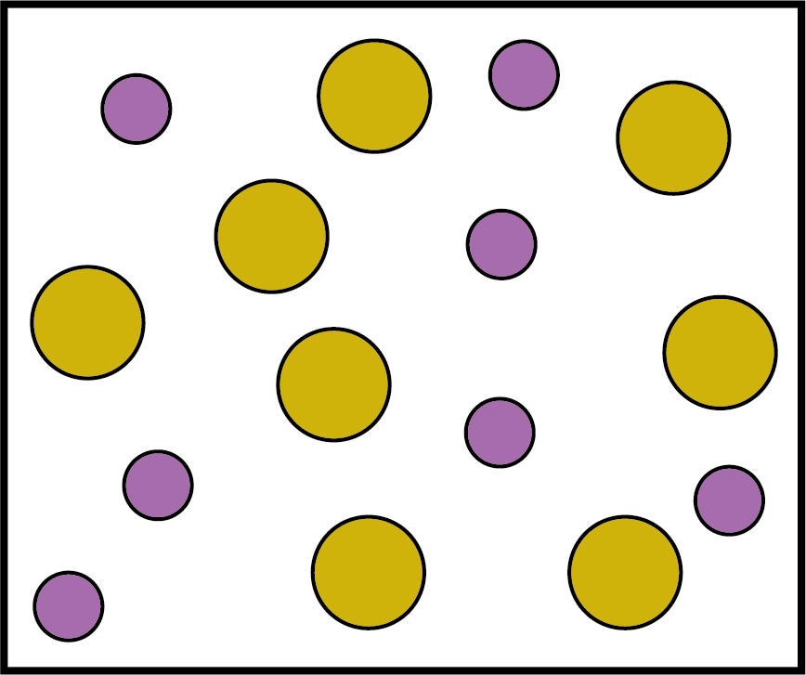
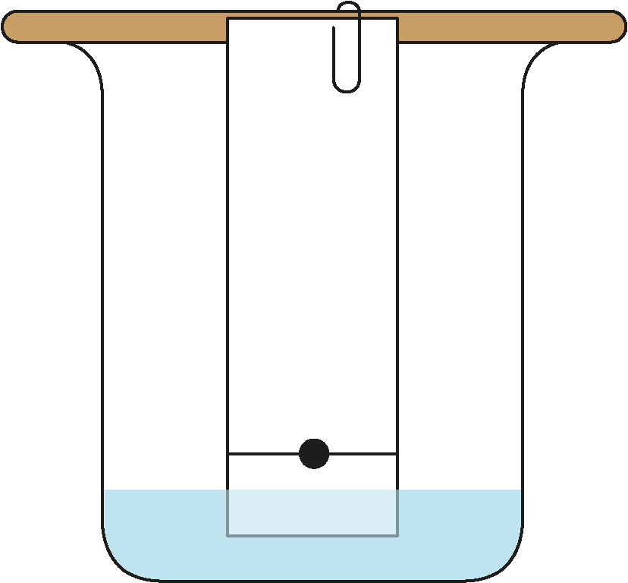
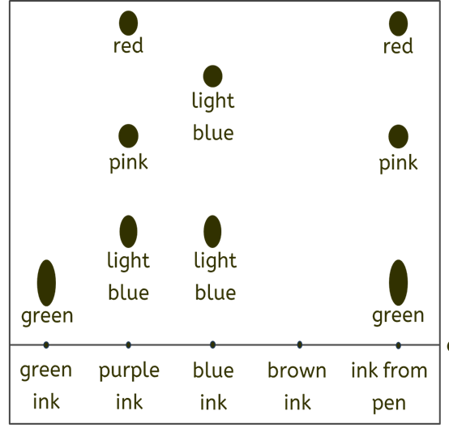
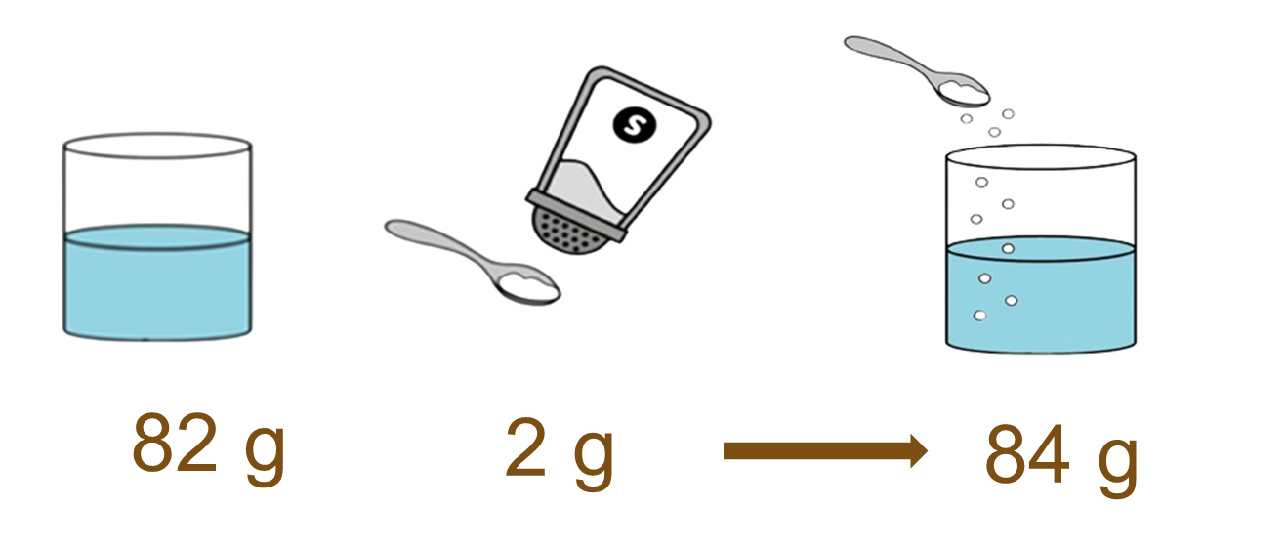
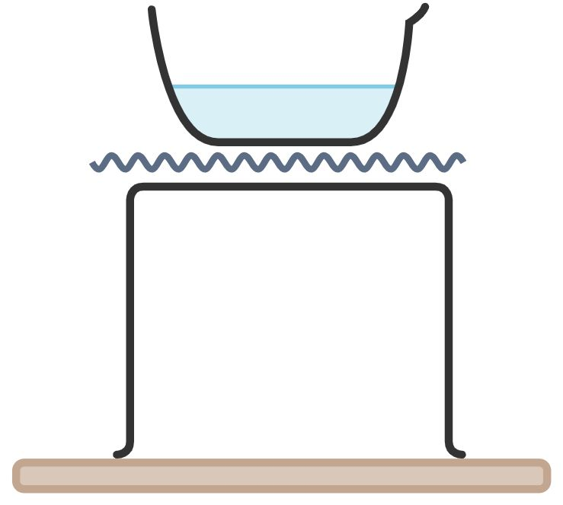

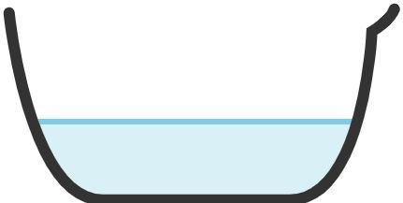
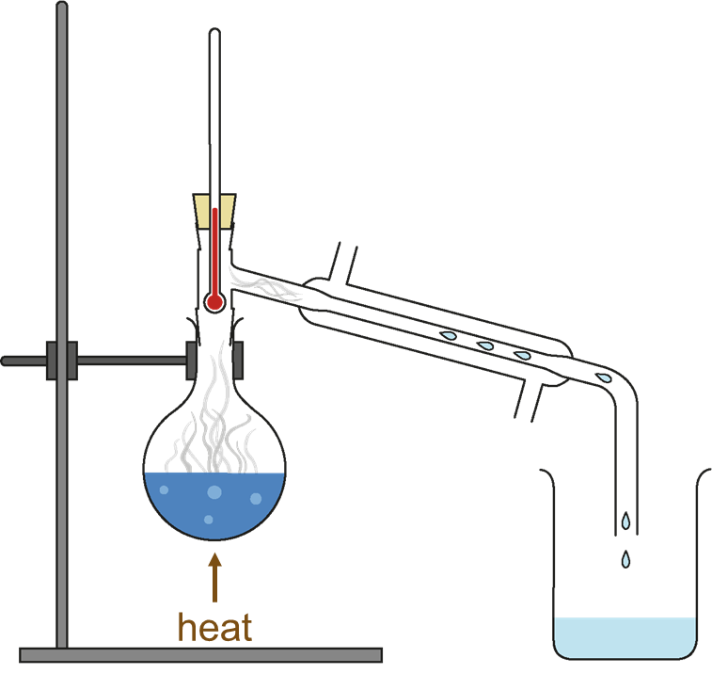
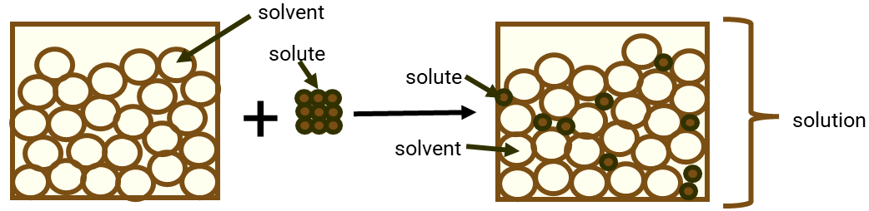
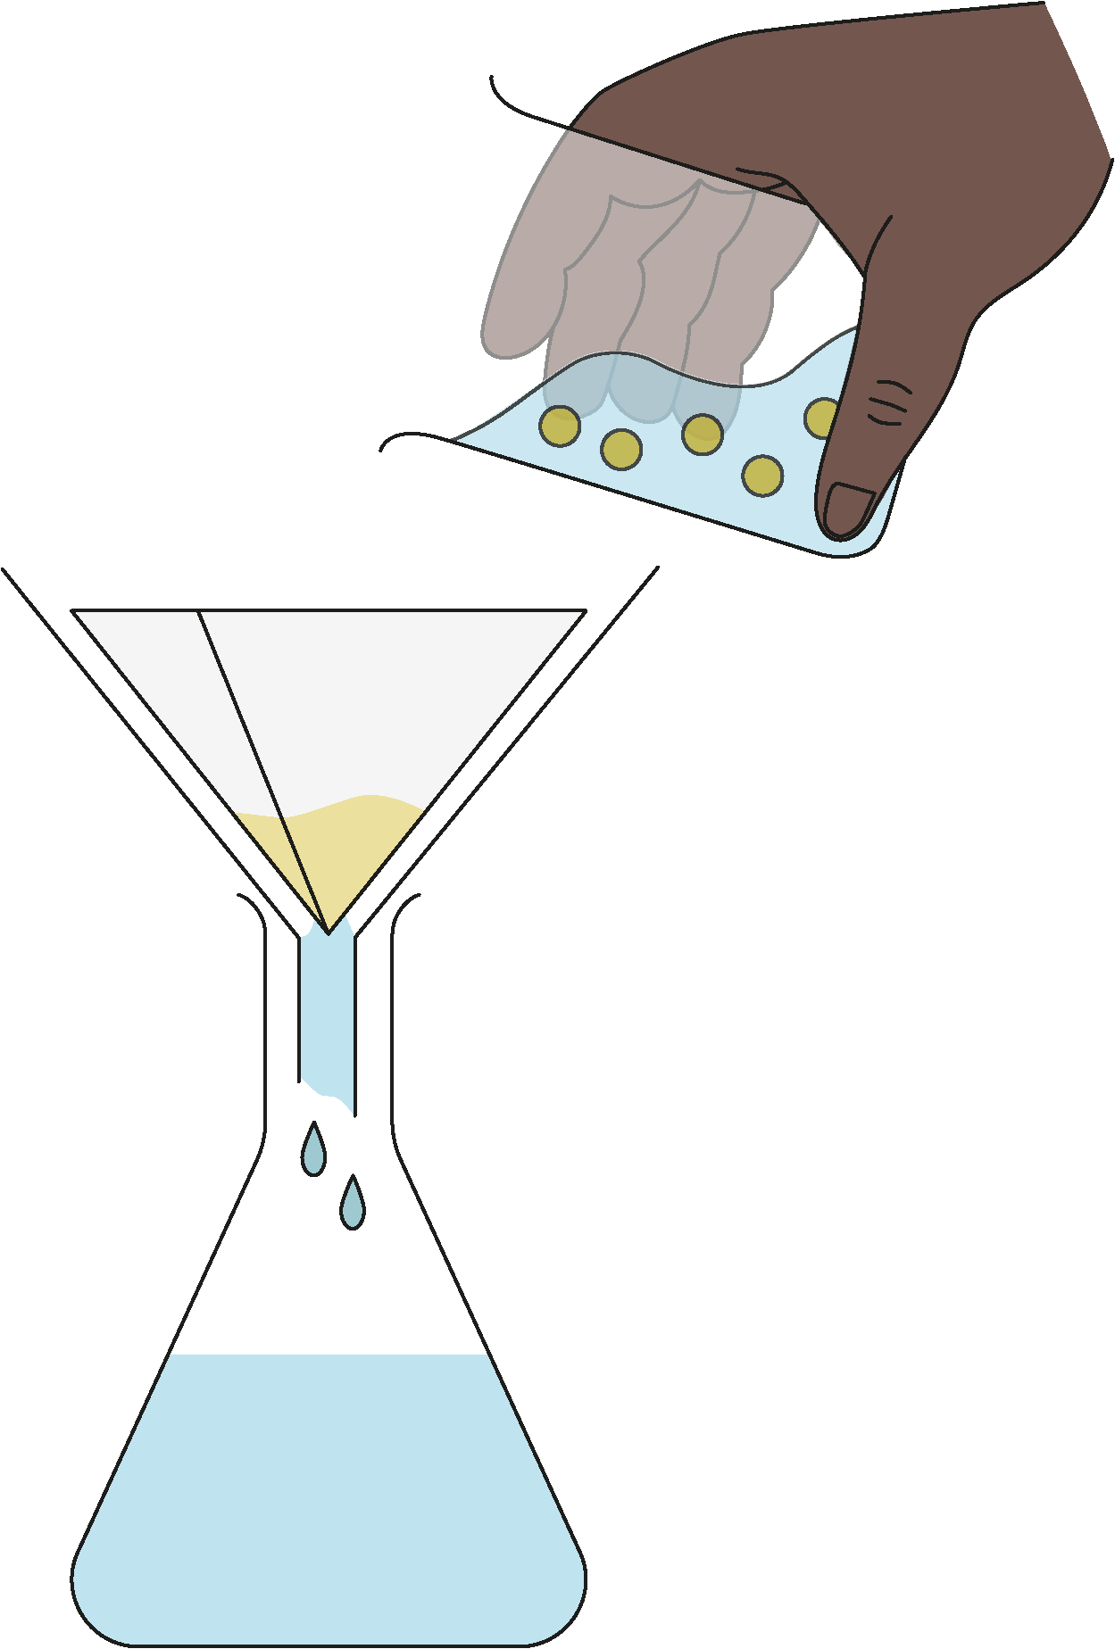
Particles, substances and mixtures
Pure substances and mixtures
Separating mixtures
A pure substance is one that contains only one substance, e.g. pure iron contains only iron particles. A mixture contains two or more substances that are not joined together and can be physically separated.
We can separate mixtures in different ways depending on their properties:
Chromatography is a separation technique that separates mixtures containing more than one solute based on their solubilities in a solvent. It works because some of the coloured substances dissolve better than others, so they travel further up the paper. A pencil line is drawn, and spots of ink or dye are placed on it. There is a container of solvent (e.g. water or ethanol). As the solvent continues to travel up the paper, the different coloured substances spread apart.
paper
pure substances
(one type of particle)
mixture
ink spot
pencil start line
Solutions and solubility
solvent
A chromatogram, the results of chromatography experiment.
A solute can be dissolved in a solvent. The mixture created is called a solution. When no more solute can dissolve in the solution, it is a saturated solution. If a solid dissolves in a solvent, it is soluble. If it does not dissolve in a solvent, it is insoluble. Solubility is a measure of how much solute can dissolve in a solvent. The higher the temperature of the solvent, the greater the mass of the solute that can be dissolved.
Solubility is different for different solutes. The solubility of a solute will change depending on the solvent used.
During dissolving, the solute particles are separated and fit between the solvent particles to make a solution.
Evaporation and crystallisation can be used to separate a soluble solid from a solution.
For example, copper sulphate is soluble in water – its crystals dissolve in water to form a copper sulphate solution. During evaporation, the water evaporates away, leaving solid copper sulphate crystals behind. Crystallisation produces larger solid crystals.
evaporating dish containing
solution
solvent
solute
gauze
solution
tripod
Bunsen
burner
Distillation is a separation technique used to separate a mixture of liquids. The basis for separation in distillation is the difference in the boiling points of the components. For example, water can be separated from an ink and water solution because water has a much lower boiling point than ink. When the solution is heated, water evaporates. It is then cooled and condensed into a separate container. The ink does not evaporate, so it stays behind.
Conservation of mass
When a solution is formed, the mass of the solvent + the mass of the solute = the mass of the solution.
Mass remains constant because the number of particles is the same before dissolving as it is after.
Filtration can be used to separate a liquid from an insoluble solid.
The filter paper used in filtration is ‘selectively permeable’, meaning that it has holes in it that allow the movement of only some substances through whilst preventing the movement of others. The insoluble solid is unable to pass through the small holes of the filter paper. When a mixture of sand and water is filtered:
The sand stays behind in the filter paper (it becomes the residue).
The water passes through the filter paper (it becomes the filtrate).
filter paper
filter funnel
residue
mixture
conical
flask
filtrate
Science | 7.01 – Particles, substances and mixtures | Knowledge Organiser
Notes:
Images:
Evaporation and crystallisation diagrams – created with Chemix (https://chemix.org)
All other images – United Learning

